Slide 1
Java 9+
The next generation. A whole new world. Not your mama’s Java. 🎉

Slide 2
Intro

Slide 3
Intro
”Java” means “Java SE” – the language, JDK, runtime, and tooling
Java 9: September 21, 2017
Java 10: March 20, 2018
Java 11: September 25, 2018 (LTS)
Java 12: March 19, 2019
Java 13: September 17, 2019
Java 14: March 17, 2020
Java 15: September 15, 2020
Java 16: March 16, 2021
Java 17: September 14, 2021 (LTS)
Java 18: March 22, 2022
Java 19: September 2022 (planned)

Slide 4
Intro
Starting after the release of Java 9 on September 21, 2017, Oracle went to a new release cadence
Major releases (new features, potential breaking changes) every 6 months
Update releases (patches) every quarter
Long-term support releases every 3 years
Support for one major release ends when then next one becomes available (except for LTS releases)
As of August 31, 2022, the current version is Java 18
Java 11: previous LTS release
Java 17: current LTS release
Java 23: next LTS release
Java 8 has been grandfathered into the cycle – public updates until at least May 2026 through Adoptium (formerly known as AdoptOpenJDK)

Slide 5
Intro
Java 10 was the first of the bi-annual releases
Six-month release cycle means less time for “big” changes
Java 9 started introducing experimental & preview features
Generally used 2-3 releases to get community feedback before being finalized as a standard

Slide 6
Intro
Language
JDK
Tooling
Runtime
Notes:
Breaking changes for these releases down by category, rather than release

Slide 7
Language
Parlez-vous Java?

Slide 8
Language
Enhancements in a nutshell:
Module system
Private interface methods
“Effectively final” in try-with-resources
Type inference
Switch expressions
Text blocks
Pattern matching
Record classes
Sealed classes

Slide 9
Language
Java 9
Java Platform Module System
(JPMS)
Additional loading & scoping capabilities
Encapsulation at the JAR level
New manifest file to declare:
Exported packages
Service implementations
External modules
a.k.a. Project Jigsaw

Slide 10
Language
Java 9
Java Platform Module System
(JPMS)
Adoption
JDK itself is the primary user
Fully restructured and repackaged as modules
Reception by the general community is lukewarm, adoption slow
Notes:
Contentious feature, took years to get out the door.
We’ll also touch on modules later because it impacted nearly every part of the platform. A full demo or tutorial is outside the scope of this presentation.

Slide 11
Language
Java 9
Private Interface Methods
Private non-virtual methods on interfaces
Interfaces with behavior?! Preposterous!
Only private methods, so of limited use
Think of them as helpers for default methods, a factoring tool
Notes:
Since these private methods can only be used by the actual interface, and not by implementors or extenders, they are just a “factoring” tool, for encapsulating common behavior needed by default methods.

Slide 12
Language
Java 9
“Effectively Final” for try-with-resources
Allows resource variables to be reused
Effectively final: Variable holding resource is not reassigned within try block
Allows using same variable in multiple blocks
Allows declaring the variable before the try-with-resources statement

Slide 13
Language
Java 10
Variable Type Inference
Infer type of local variable from assignment
New keyword: var
Variable type inferred from expression on right-hand side
Works in the following places:
Local variables that are initialized where they are declared
Variables declared as part of a for or for-each loop

Slide 14
Language
Java 10
Variable Type Inference
Infer type of local variable from assignment
Similar to Groovy’s def, but variable type is specific
Be judicious – don’t sacrifice readability
Type of right-hand side should be obvious
In Java 11, the var keyword was expanded to be allowed in implicitly typed lambda expressions
Notes:
Best limited to prototype code, very small methods, and test methods.

Slide 15
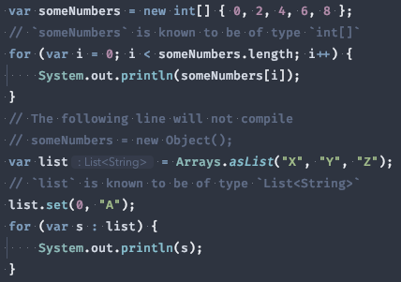
Language
Java 10
Variable Type Inference
Infer type of local variable from assignment

Slide 16
Language
Java 14
Switch Expressions
Use a switch as an expression
Simplifies assigning a value based on a switch
Prevents errors from forgetting to break
Scopes variables to the case, rather than the whole switch block
Existing switch statement remains unchanged
Notes:
Preview started in Java 12, refined in 13, standardized in 14

Slide 17
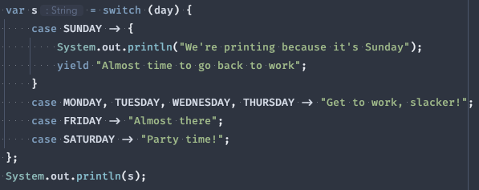
Language
Java 14
Switch Expressions
Use a switch as an expression
Notes:
Preview started in Java 12, refined in 13, standardized in 14

Slide 18
Language
Java 15
Text Blocks
Simpler multi-line string declarations
Declare string literals over multiple lines
Avoids the need for most escape sequences
Provides predictable, controllable formatting
Notes:
Preview started in Java 13, refined in 14, standardized in 15

Slide 19
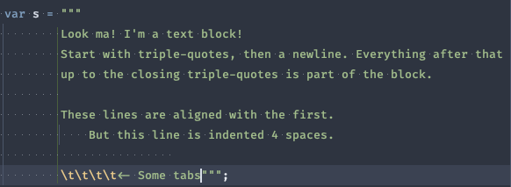
Language
Java 15
Text Blocks
Simpler multi-line string declarations
Notes:
Preview started in Java 13, refined in 14, standardized in 15

Slide 20
Language
Java 16
Pattern Matching
Pattern matching for instanceof expressions
Essentially combines the comparison and cast into one expression
New variable of the inferred type is immediately usable
Notes:
Previewed in Java 14 and continued without changes in 15. Standardized in 16 (with a couple of minor tweaks).

Slide 21
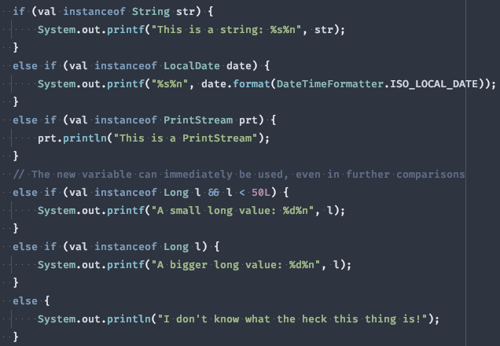
Language
Java 16
Pattern Matching
Pattern matching for instanceof expressions
Notes:
Previewed in Java 14 and continued without changes in 15. Standardized in 16 (with a couple of minor tweaks).

Slide 22
Language
Java 16
Record Classes
Declare simple ‘data holder’ classes
Merge declaration of class, member variables, and constructor
Only a single, “canonical” constructor is allowed
Auto-generates basic Object methods:
equals
hashCode
toString
Notes:
Preview started in Java 14 and continued in 15. Standardized in 16. Similar in function to Lombok’s @Data annotation.

Slide 23
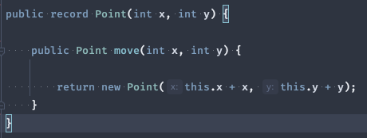
Language
Java 16
Record Classes
Declare simple ‘data holder’ classes
Notes:
Preview started in Java 14 and continued in 15. Standardized in 16. Similar in function to Lombok’s @Data annotation.

Slide 24
Language
Java 17
Sealed Classes
Allow classes/interfaces to restrict their extenders
Classes declare which other classes may extend them
Interfaces declare which classes may implement them
Provides some safety without declaring a class final
Will support future uses of pattern matching
Notes:
Preview started in Java 15

Slide 25


Language
Java 17
Sealed Classes
Allow classes/interfaces to restrict their extenders
Notes:
Preview started in Java 15

Slide 26
Language
Java 18 (preview)
Pattern Matching for switch
Use pattern matching in switch expressions and statements
Extends the concept of pattern matching (first introduced for instanceof in Java 14)
Notes:
Preview started in Java 17

Slide 27
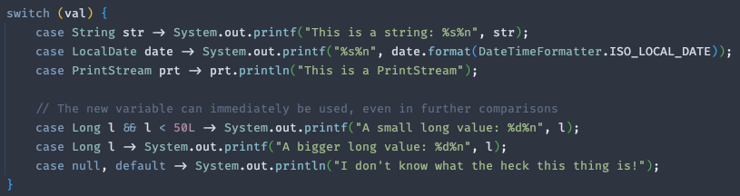
Language
Java 18 (preview)
Pattern Matching for switch
Use pattern matching in switch expressions and statements
Notes:
Preview started in Java 17

Slide 28
JDK
more development for your kit since 1996

Slide 29
JDK
Enhancements in a nutshell:
Reactive streams
HTTP client
TLS 1.3
Reimplemented socket APIs
Improved NullPointerException
Modularity and cleanup
Removed modules
Eliminated modules

Slide 30
JDK
Java 9
Reactive Streams
Primitives for reactive programming
Introduces standardized primitives for reactive programming (including backpressure)
Not intended for direct use by consumers
Instead, provides interop between libraries & frameworks that implement the primitives
Notes:
Notable implementers are Akka, Project Reactor, Vert.x, and more

Slide 31
JDK
Java 11
HTTP Client
An HTTP client baked into the standard library
Huge improvement over java.net.URLConnection
Supports HTTP 1.1 & 2.0, TLS
Heavy use of Fluent Builder pattern
Separate module: java.net.http
Not as performant as OkHttp or Apache HttpComponents
Notes:
Due to its performance, probably not the choice for production-grade applications. But a fine choice for scripts, prototypes, etc.

Slide 32
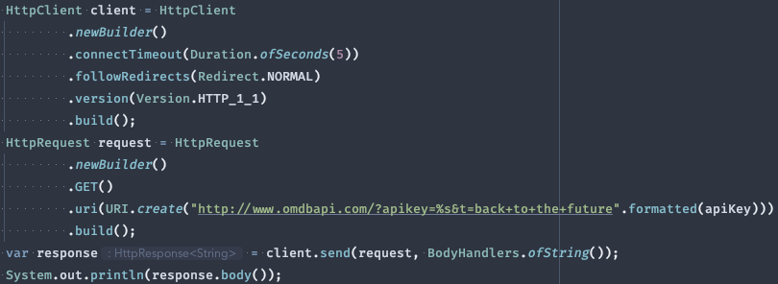
JDK
Java 11
HTTP Client
An HTTP client baked into the standard library

Slide 33
JDK
Java 11
TLS 1.3
Implement the latest TLS standard
Upgrades the Java Secure Socket Extension (JSSE)
Adds support for the TLS 1.3 protocol
Adds new cipher suites required by TLS 1.3
Removes some older, insecure cipher suites

Slide 34
JDK
Java 13 & 15
Reimplement Socket APIs
Reimplement the archaic socket API internals
Previous implementations had been around since 1.0
Brittle & inefficient hybrid Java/C implementation
Insufficient for supporting upcoming JVM enhancements
Java 13: Reimplement TCP sockets
Java 15: Reimplement UDP sockets

Slide 35
JDK
Java 14
Improved NPE
Enhanced NullPointerException error messages
Helps with chains of references or calls
Pinpoints exactly which object was null
Details the operation that was attempted
https://openjdk.java.net/jeps/358

Slide 36

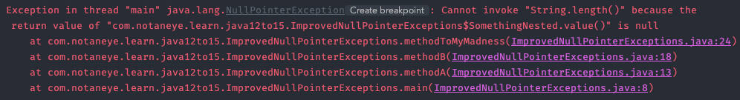
JDK
Java 14
Improved NPE
Enhanced NullPointerException error messages

Slide 37
JDK
Java 17
Hex Formatter
java.util.HexFormat
Converts between primitives values and hexadecimal-encoded strings
Notes:
Will you use it everyday? No. Will it be handy when you need it? You bet.

Slide 38
JDK
Java 17
Deprecate Security Manager
Deprecate the Security Manager and mark it for removal
Outdated design
Limited adoption
Notes:
Seriously, raise your hand if you’ve ever implemented code that uses the Security Manager

Slide 39
JDK
Java 9 - 18
Modularity & Cleanup
Modularize the JDK and perform some housekeeping
Split the monolithic JDK into multiple libraries that can be included or excluded from the JVM, as needed
Infrequently-used modules are now excluded by default
Obsolete modules have been completely eliminated
Hid internal APIs
Notes:
The module system allowed the JDK maintainers to start removing some of the cruft that had built up in the platform over the years.

Slide 40
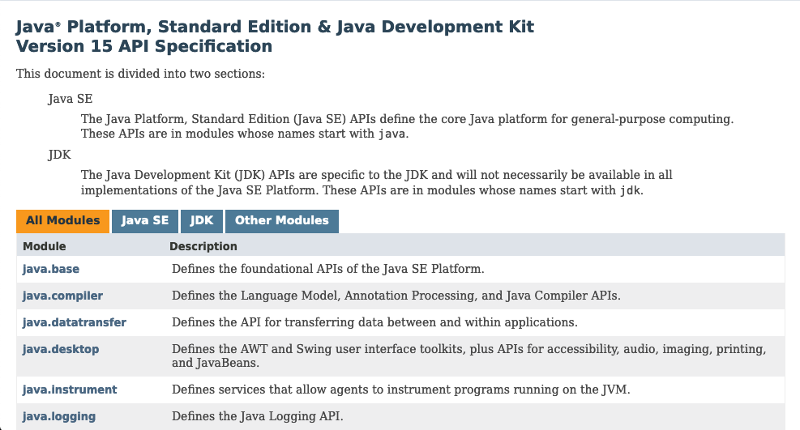
JDK
Java 9 - 18
Modularity & Cleanup
Modularize the JDK and perform some housekeeping
Notes:
The platform Javadoc is now broken down by modules at the top-level. Drill into the module to see the packages available. Nearly everything you'll use day-to-day is in the `java.base` module.

Slide 41
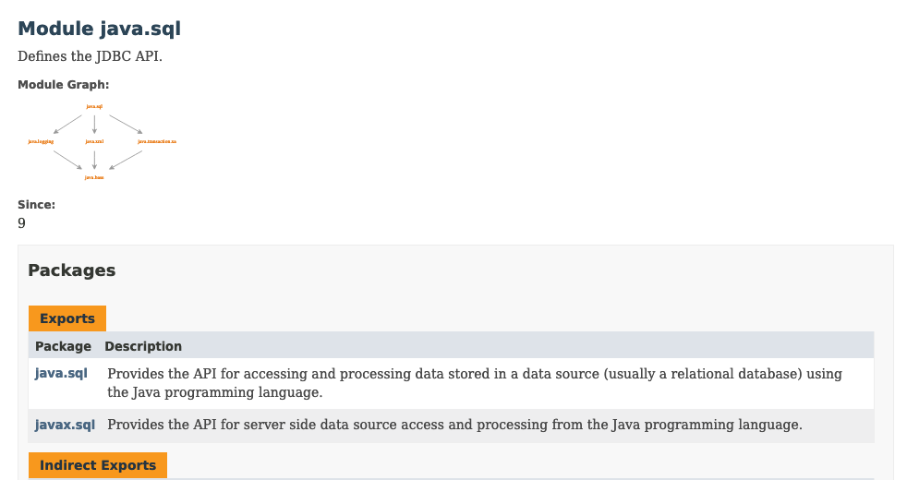
JDK
Java 9 - 18
Modularity & Cleanup
Modularize the JDK and perform some housekeeping
Notes:
Note the “module graph” at the top of the module documentation. this shows the module’s imports (dependencies) and exports.

Slide 42
JDK
Java 9 - 18
Modularity & Cleanup
Modularize the JDK and perform some housekeeping
Removed from the standard JDK/distribution, but still available as standalone components:
JavaFX (11)
Java EE (11)
CORBA (11)
Nashorn JavaScript engine (15)

Slide 43
JDK
Java 9 - 18
Modularity & Cleanup
Modularize the JDK and perform some housekeeping
Eliminated, disappeared, disavowed, dead ‘n’ gone, six feet under:
JavaDB
Java Applets (Plugin gone, APIs still exist in JDK, but have been marked for removal)
Java Web Start

Slide 44
Tooling
All I see is nails…

Slide 45
Tooling
Enhancements in a nutshell:
Module system
jlink
Javadoc
JShell
jpackage
Ahead-of-time compilation (GraalVM)
Shell scripts
Flight Recorder
Simple Web Server

Slide 46
Tooling
Java 9
Java Platform Module System
(JPMS)
Existing tools updated to support modules
Notably, the concept of “module path” was introduced
Classpath still works as before
JARs and classes in the classpath are part of an unnamed module
JARs included as part of the module path follow the rules of modules (more strict than “old-school” JARs)

Slide 47
Tooling
Java 9
Module system –jlink
New tool to build custom JVM distributions
jlink allows custom JVM distributions to be built with just the needed modules
Includes custom & 3rd party modules, not just JDK modules
Output is a custom, self-contained JVM
Useful for creators of off-the-shelf software, and for creating “lean” application images
jlink tool documentation

Slide 48
Tooling
Java 9
Javadoc
Javadoc looks a little different
Replace the “framed” interface with an HTML5-compliant SPA
Direct navigation through a search box
Support modules

Slide 49
Tooling
Java 9
JShell
A REPL for Java
REPL = “read-evaluate-print-loop”
Command line tool to quickly run Java code
Very useful for rapid prototyping or exploration of a library
JShell documentation

Slide 50
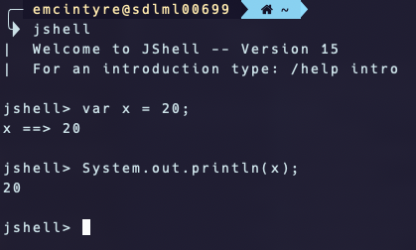
Tooling
Java 9
JShell
A REPL for Java

Slide 51
Tooling
Java 15 (preview)
jpackage
New tool to build platform-native packages
Works on top of jlink
Creates installable packages for any supported platform
macOS (pkg, app/dmg)
Windows (exe, msi)
Linux (deb, rpm)
jpackage tool documentation
Notes:
This is native package distribution, not to be confused with native binaries, which is a segue to....

Slide 52
Tooling
Java 9
Ahead-of-time compilation
New compiler/runtime toolchain, GraalVM
Ahead-of-time compilation (native binary)
Also an alternate JIT compiler
Supports multiple languages and bytecode formats
https://www.graalvm.org/
Notes:
This brief intro doesn’t do it justice. We could have a whole session on GraalVM.

Slide 53
Tooling
Java 11
Shell scripts
Single-file programs, a.k.a. Java shell scripts
Yet another Groovy feature that makes its way into official Java
Execute Java source files directly: java MyProg.java
Supports “shebang” files: #!/path/to/java
Single-File mode documentation

Slide 54
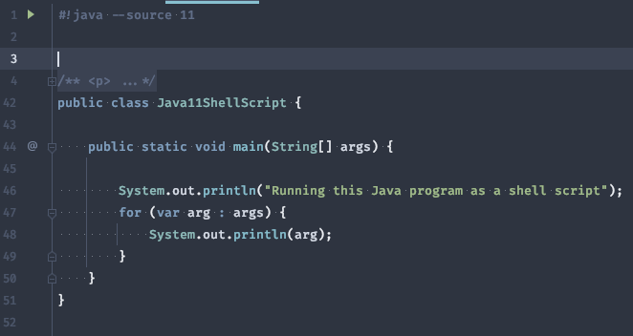
Tooling
Java 11
Shell scripts
Single-file programs, a.k.a. Java shell scripts

Slide 55
Tooling
Java 11
Flight Recorder
Debugging tool to collect data on running JVM
Can be enabled when launching the JVM or on a running process
Useful for profiling and post-mortem analysis
Notes:
Attaching it to a running process, even if it was not launched with profiling enabled, is a huge win

Slide 56
Tooling
Java 18
Simple Web Server
Minimal static web server
Very much not for production
Does not run servlets or otherwise serve dynamic content
Run from command line or via API
Notes:
Personally, I'm having a hard time coming up with a use case for this one, but the Benevolent Overlords have deemed it a Highly Useful Feature 🤷

Slide 57
Tooling
Java 18
Javadoc Code Snippets
Support code snippets in Javadoc comments
@snippet tag
For including code examples in API documentation
https://docs.oracle.com/en/java/javase/18/code-snippet/index.html

Slide 58
Runtime
Is anyone even reading these?

Slide 59
Runtime
Enhancements in a nutshell:
Module system
Reflection
Performance improvements
Garbage collection
Thread management
Unicode
Encryption
Hidden classes

Slide 60
Runtime
Java 9
Java Platform Module System
(JPMS)
Support modules at runtime
”Module path” is separate from “classpath”
Support interoperability between modular and non-modular code
Modules also provide additional visibility guarantees

Slide 61
Runtime
Java 9
Java Platform Module System
(JPMS)
Multi-release JAR files
JAR files can contain classes specific to a Java release
The module loader will ensure these get loaded before the more general classes
Notes:
For instance, a library can contain three versions of `Foo.class`: one that relies on Java 14 features, one that relies on Java 11 features, and a generic one. The platform will load whichever one is most “compatible”.

Slide 62
Runtime
Java 18
Reimplement Reflection
Reflection reimplemented with better primitives
The reflection code has been updated to work with a newer mechanism called Method Handles
Code that uses reflection to circumvent things like private or final must be updated
Notes:
For instance, a library can contain three versions of `Foo.class`: one that relies on Java 14 features, one that relies on Java 11 features, and a generic one. The platform will load whichever one is most “compatible”.

Slide 63
Runtime
Various
Performance improvements
Improve threading and garbage collection
Java 10 implemented a unified garbage collector interface
Old garbage collectors retired
Several new GC algorithms implemented
“Thread-Local handshakes” to improve performance of signaling threads
Notes:
Implementing new garbage collectors might be the JVM team’s favorite pastime

Slide 64
Runtime
Various
Unicode
Better Unicode support
Java 9 updated Unicode to 8.0
Java 11 updated Unicode to 10.0
Java 13 updated to Unicode 12.1
Java 15 updated to Unicode 13.0
Java 18 uses UTF-8 by default, regardless of platform and system configuration
Notes:
Thousands of new code points and many new scripts

Slide 65
Runtime
Various
Encryption
Enhance encryption support within the JDK
Remove deprecated/insecure ciphers and hashes
Add new algorithms
Update TLS certificates and infrastructure
Notes:
Thousands of new code points and many new scripts

Slide 66
Runtime
Java 15
Hidden classes
Hidden, dynamically defined classes
Intended for use by frameworks that generate classes at runtime and use them via reflection
Prevents non-framework code from accessing the internals of the framework

Slide 67
Epilogue
To summarize, in conclusion, wrapping up…

Slide 68
Epilogue
After years of relative stagnation, the Java platform has seen extraordinary evolution in the last 5+ years
Modules are a huge addition, but not the seismic shift that was expected
jlink (along with GraalVM) is a huge boon for the cloud-native space
jpackage could really open up the possibilities for Java-based desktop apps
Java shell scripts could also prove to be very useful
The really cool stuff is the more recent language enhancements under Project Amber (https://openjdk.org/projects/amber/):
Type inference
Text blocks
Pattern matching
Record & sealed classes
Notes:
Java feels more like a “cool” language again

Slide 69
Epilogue
The additions of Records, Sealed Classes, and Pattern Matching are starting Java on the journey toward Algebraic Data Types:
Better type safety
Immutability by default
Easier object destructuring
Notes:
Unfortunately, some improvements won’t make it into the language for a long time, if ever: better null safety, untyped tuples, etc.

Slide 70
Epilogue
What’s next?
Project Loom – Lightweight threads (a.k.a. “fibers”), plus “structured concurrency” https://openjdk.java.net/projects/loom/
Underway in Java 19 – JEPs 425 & 428
Project Panama – Better native interoperability https://openjdk.java.net/projects/panama/
Underway since Java 14
Project Valhalla – Value types, with efficient memory layout and no identity (midway between primitives and objects) https://openjdk.java.net/projects/valhalla/
Some preparatory work has been done since Java 11
The Good Bits are still to come…
Notes:
My hope is that Loom introduces a language-level (or at least, JDK-level) mechanism for message passing, a la Akka’s Actors or Go’s goroutines & channels. Valhalla should eventually eliminate the line between primitives and objects, making classes like `Integer` and `Character` obsolete. It will also allow defining custom types that behave like primitives in some respects.

Slide 71

Q & A

